Slide 1
Data Warehouse And Data Mining
Project Report

Slide 2
E-Commerce Product
Recommendation System
An intelligent system that analyzes customer purchase patterns and user similarity to deliver personalized product recommendations at scale.
Group Members
23BCE9836 - G.Sharun
24BCD7127 -Raghava

Slide 3
Problem Statement
The Problem
The Solution
Customers struggle to find relevant products among thousands of items on large e-commerce platforms — leading to poor shopping experiences and reduced sales.
An intelligent recommendation system that analyzes purchase patterns and user similarity to surface the right products for each customer — automatically and at scale.

Slide 4
Approach
Data Collection & Preprocessing
1
Use an e-commerce dataset with customer transactions. Clean data, remove missing values, and convert to a suitable format.
FP-Growth Algorithm
2
Apply market basket analysis to discover products frequently bought together.
Collaborative Filtering
3
Build a user–item interaction matrix to identify similar users and recommend based on purchase behavior.
Integration & Visualization
4
Combine FP-Growth and Collaborative Filtering results, then display insights via an interactive dashboard.

Slide 5
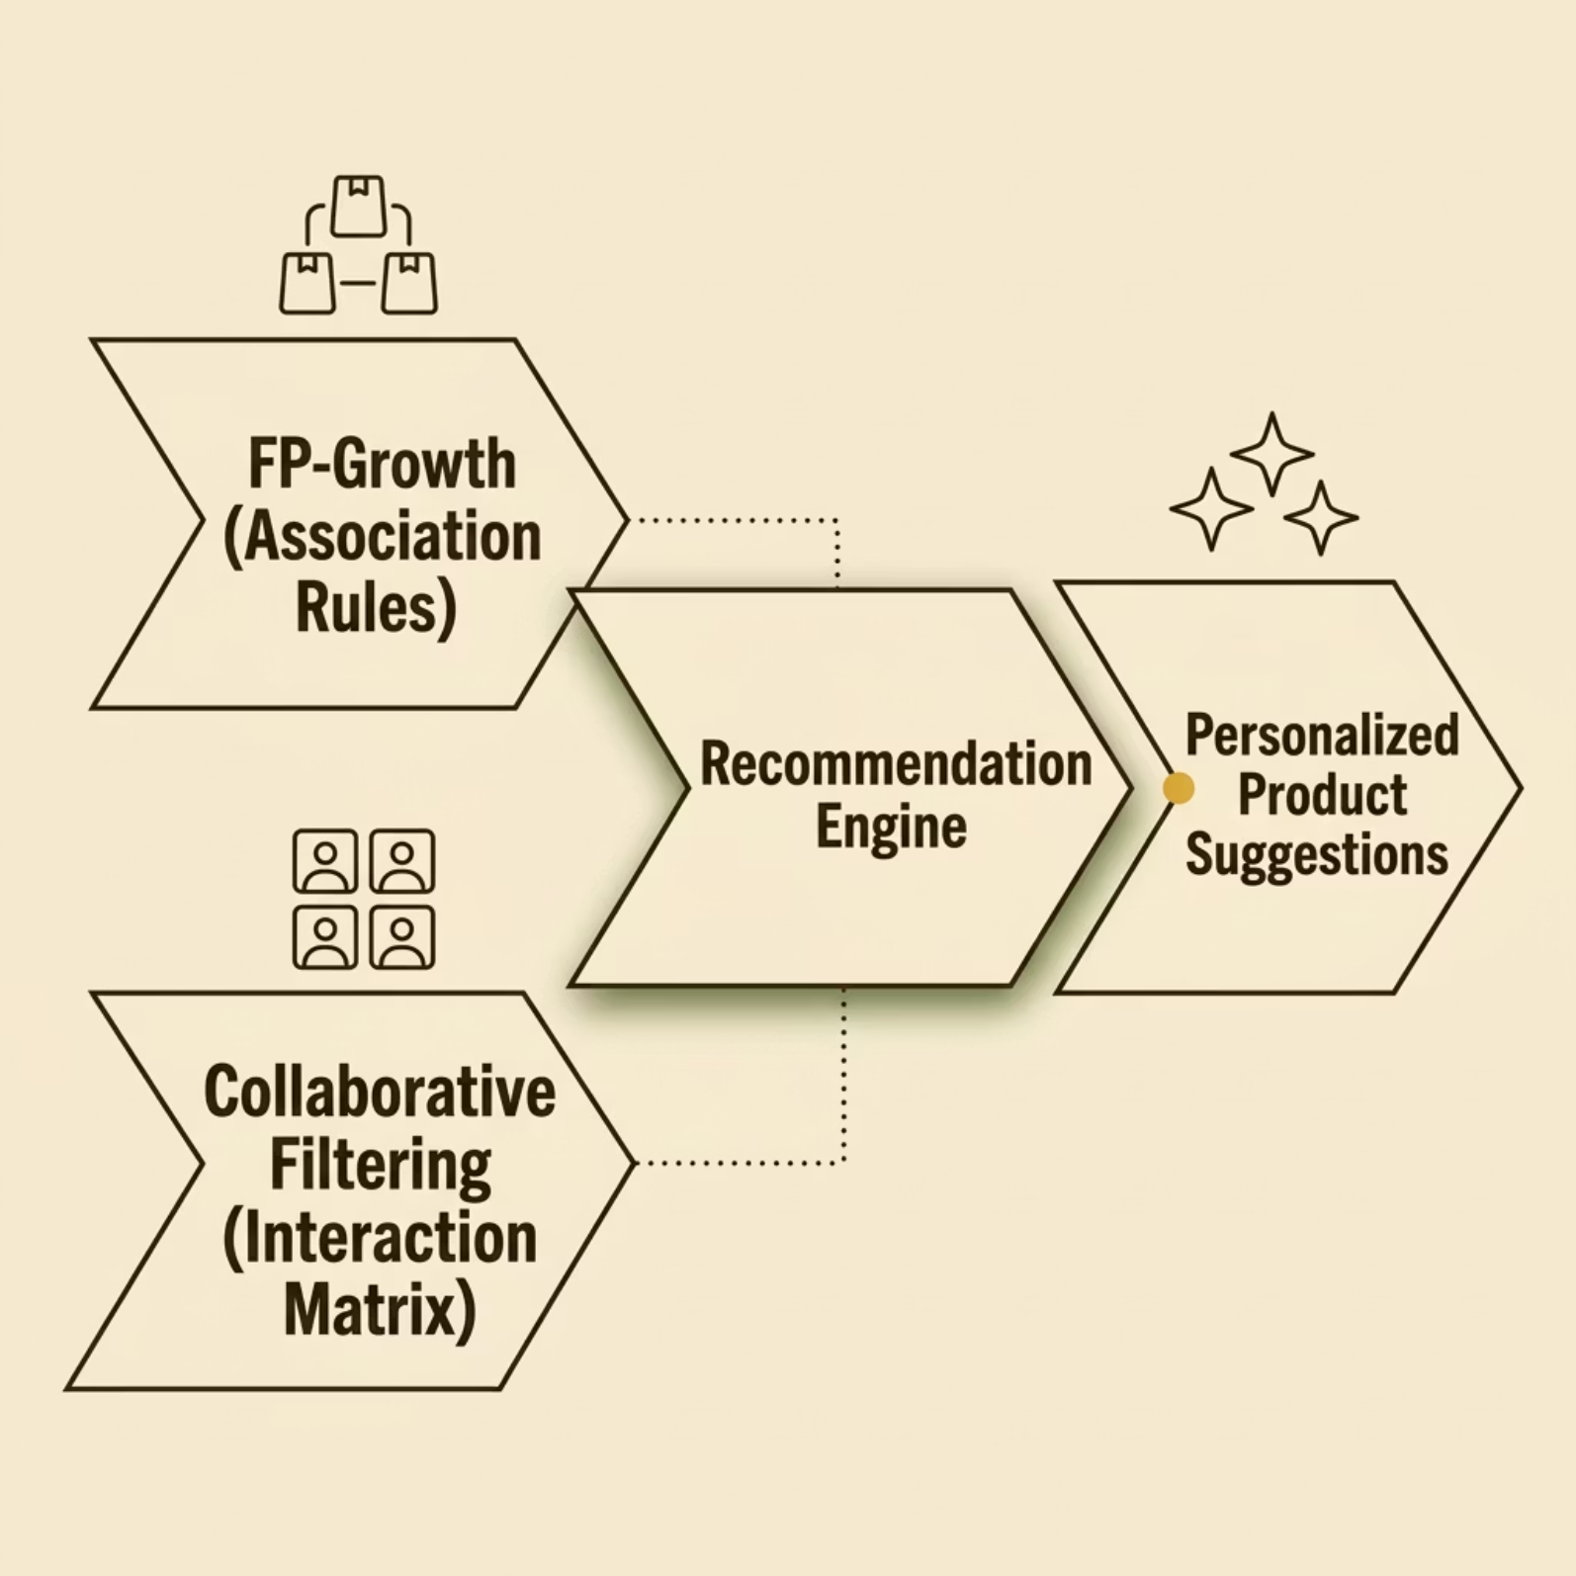

How the System Works
FP-Growth
Finds products that are often bought together by analyzing frequent patterns in data.
Collaborative Filtering
Recommends items based on the preference of similar users.
it assumes users with similar behaviour will like similar products

Slide 6
6-Week Line of Action
Week 1
1
Problem understanding & dataset collection
2
Week 2
Data preprocessing
Week 3
3
FP-Growth algorithm implementation
4
Week 4
Collaborative filtering implementation
Week 5
5
Recommendation system integration
6
Week 6
Visualization & final evaluation

Slide 7

Tools & Technologies
Python
VS Code
Tableau
Core programming language for algorithm development and data processing.
Interactive development environment for building and testing the recommendation models.
Visualization dashboard to display product trends and recommendation insights.
DataSet Used
InstaCart Online Grocery dataset-Kaggle
link--https://www.kaggle.com/datasets/yasserh/instacart-online-grocery-basket-analysis-dataset

Slide 8
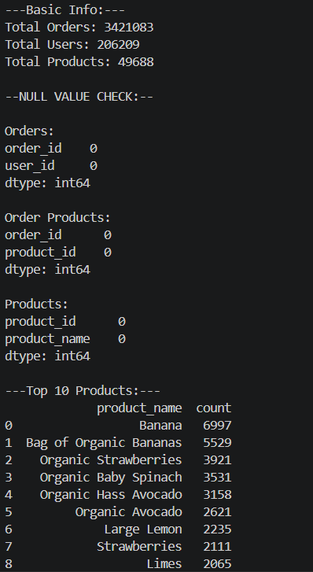
Exploratory Data Analysis Result

Slide 9
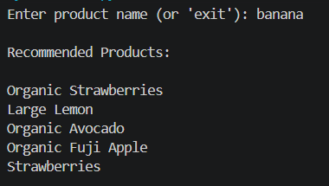

Result
The system generates product recommendations based on user input. Below are sample outputs:
The entered product does not exist in the dataset used by the system.
Hence, no recommendations can be generated for the given input.

Slide 10


The product exists in the dataset but was excluded during preprocessing and model training.
This occurs due to filtering of less frequent items to improve performance and reduce sparsity.
The scores represent the average recommendation strength generated by each model. The hybrid model achieves a higher score compared to individual models, indicating improved recommendation quality by combining similarity-based and association-based approaches.

Slide 11
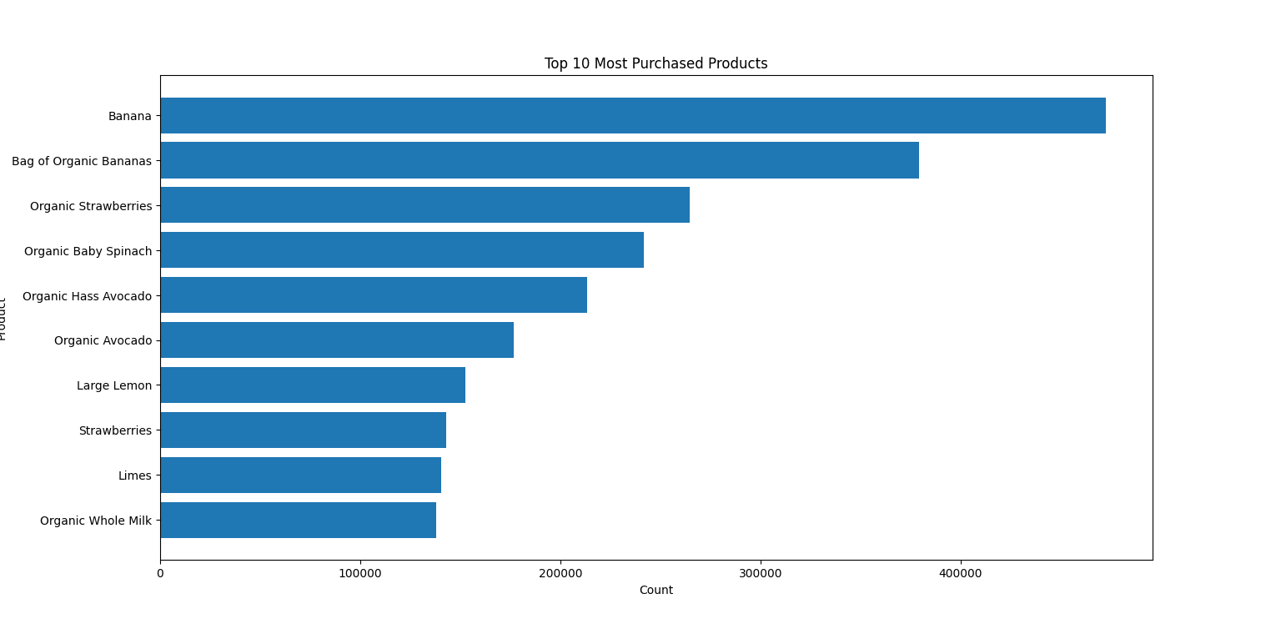
Visualizations
1)Top products bar chart
Bar chart of most frequently purchased products

Slide 12
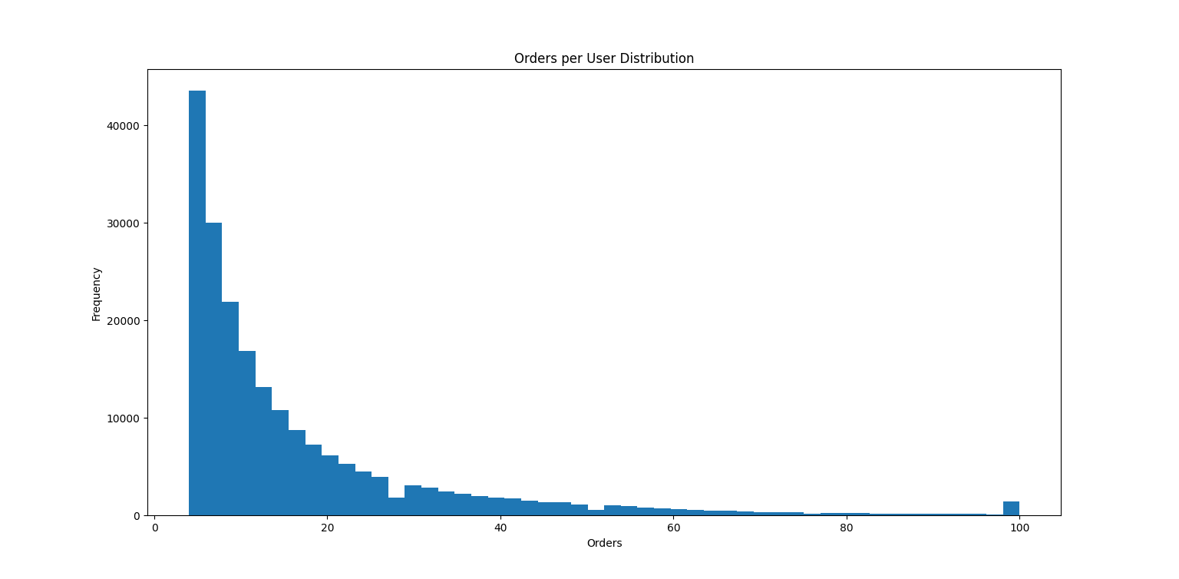
2)Orders per User Distribution
Histogram of number of purchases per user

Slide 13
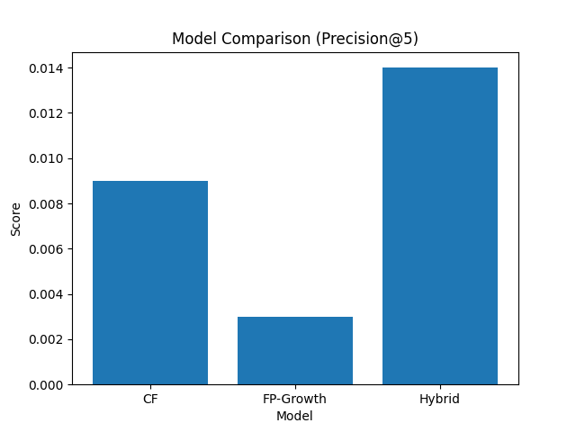
3)Model Comparision graph

Slide 14
Conclusion
Developed a hybrid recommendation system combining Collaborative Filtering and FP-Growth
Successfully generated personalized and relevant product recommendations
Hybrid approach improved recommendation quality and diversity compared to individual models
System effectively handles large datasets and real-world scenarios
GitHub link:
https://github.com/sharun-g/ecommerce-recommendation-system.git

